Slide 1


Slide 2
Design Sprint 1 | Team Split
 | DS1 Team 1 | DS1 Team 2 | DS1 Team 3 | DS1 Team 4
Design Sprint 1 (Bluster B & C: Online) Lead: Selam | Job Dulo | Ronald Kudoyi | Benson Njuguna Kariuki | Katinka Harsanyi
 | Alistair Gould | Brian Mwangi | Dmitry Spitsberg | Kennedy Mukuna
 | Bryan Waweru | James Macharia | Fanen Acho | Michael Denuh
 | Walela Masibo | Clementine Vandeleur | Jennifer Mpho Lebethe | Nwachukwu Ossai
 | Peter Kihara Joyce | Yixuan "Layla" Li | John Kiptum Juma | Phillip Chele
 |  |  |  | Thabani Magubane
 | DS1 Team 5 | DS1 Team 6
Design Sprint 1 (Cluster A: In Person) Lead: Marie | Daniel Nordberg | David Lemayian
 | Peng Chen | Simon Sondern
 | Jamie Pujara | Mikul Shah
 | Tracy Matia | Sonali Sanghrajka
 | Ashish Patel | Ore Alemede
 | David Njonjo

Slide 3
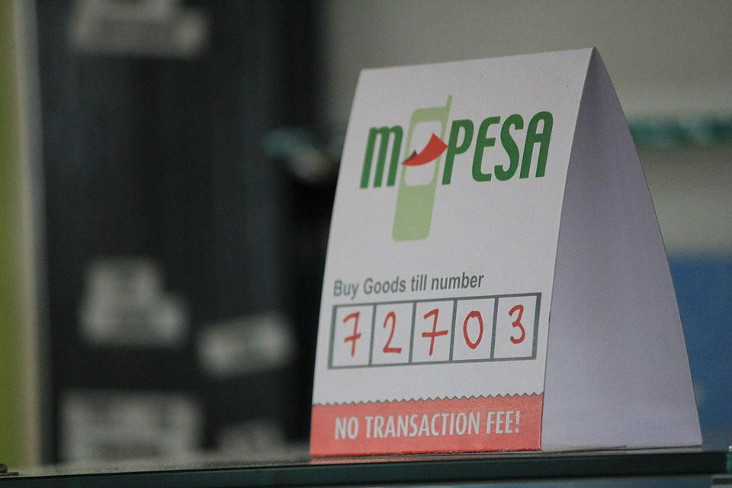
DESIGN SPRINT 1
“Disrupting mpesa”

Slide 4
There are 29.1 Million Mobile Money subscribers in Kenya with 98.8% of these being with M-PESA
Source | Safaricom quarterly report April 2020

Slide 5
There are 202K Mobile Money Agents in Kenya, out of which 85.72% are M-PESA agents
Source | Safaricom quarterly report April 2020

Slide 6
$13.2 Billion has been transacted via mobile money between March - June 2020
An historic high transaction volume of $3.7Billion was made via mobile money in the month of June following a 90 day transaction fee exemption to combat COVID 19*
* For all transactions below 1000 KES
Notes:
Source CGTN Africa, Aug 5th
Number is 18.8% of Kenya’s GDP
https://africa.cgtn.com/2020/08/05/kenyas-mobile-money-use-surges-on-covid-19-prevention-measure/

Slide 7
However, in Q1 2020...
SAFARICOM lost 0.3% market share
The year-on-year growth in mobile money payment transactions has indicated to be the lowest since M-PESA was rolled out in March 2007

Slide 8
M-PESA shows signs of weakness in...
High transactional fees (2-7%)
Outdated network and tech infrastructure
Subpar user experience
Occasional outages that have nudged users to open accounts with other operators as backup
Aggressive competitors eyeing the market (Alipay, WeChat)
Almost non-existent corporate innovation (They shut down their innovation unit Safaricom Alpha in 2019)
Notes:
Potential additional issues
Where are they weak
From user experience,
Its ready to be disrupted
They don’t own their own tech. It’s working on huawei tech
It’s not invested on
Costs are quite high
Safaricom/voda group hug mpesa too tightly

Slide 9
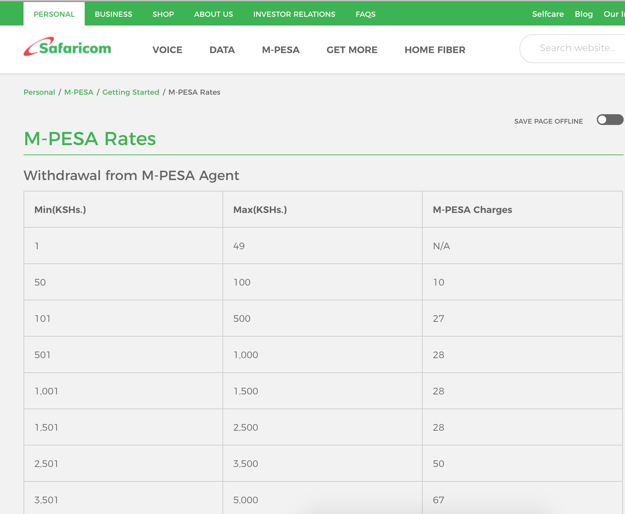
Notes:
Full rates > https://www.safaricom.co.ke/personal/m-pesa/getting-started/m-pesa-rates

Slide 10
AS A TEAM OF DISRUPTIVE FOUNDERS, HOW WILL YOUR TEAM PLAN TO CHALLENGE MPESA?

Slide 11



Your challenge!
Design a technology-driven solution that can disrupt M-PESA addressing ...
A payment problem not solved well today...
...With an attractive
business model...
...that can
cost effectively scale

Slide 12


3 areas and questions to think about...
What problem are you solving?
What pain-point/problem is critical to solve?
Who is the problem relevant for (target customer)?
Would anyone be willing to pay for this issue to be solved?
What is your superior solution?
What does your solution/product look like?
What is your value proposition/selling point to consumers?
What is your moat?
Is the business financially viable?
How big is the market opportunity?
How will you commercialize your solution (business model)?
How will you cost effectively reach your target customer at scale?

Slide 13


We will review your end product in light of
Problem definition:
How big is the problem you identified?
How clearly defined is your target customer?
Solution, feasibility & competitiveness:
Would your solution effectively eliminate or reduce the problem?
How scalable is your solution?
Presentation:
Can you sell the core of your idea in a few simple slides?
Do you work as a team?

Slide 14
Timetable: Sept 2020 (For Group A)
15:20 - 15:30
Introduction to Design Sprint 1
15:30 - 17:30
Work on problem identification + Solution Ideation
Wed Sept 9
09:00 - 12:30
Work session part II (Online for Group A)
13:30 - 15:45
Other Antler activities (Online for Group A)
15:45 - 17:30
3 min presentation | 3 min Q&A (Online for Group A)

Slide 15
Timetable: Sept 2020 (For Group B)
13:30 - 13:45
Introduction to Design Sprint 1
13:50 - 17:00
Work on problem identification + Solution Ideation
Wed Sept 9
09:00 - 10:45
Work session part II (In the office for Group B)
11:00 - 12:30
Team challenge (In the office for Group B)
13:30 - 15:45
Other Antler activities (In the office for Group B)
15:45 - 17:30
3 min presentation | 3 min Q&A ( (In the office for Group B)

Slide 16

www.antler.co

